Slide 1
Software development life cycle model

Slide 2



Starter …

Slide 3
What is software benefit?
What is software feature?

Slide 4


Work in group think about benefit of online geshouse system.
(Ex. 01)

Slide 5

Plan
1 | To know the main activity of SDLC
2 | Detail about all phases of SDLC
3 | Understand the input and output (documents) of each step

Slide 6
SDLC Overview
A process for planning, creating, developing and testing quality software's

Slide 7
What SDLC?
SDLC, Software Development Life Cycle
Is s process through a series of phases from conception to implementation system.

Slide 8
Activity: SDLC Phases
Try to put in the right order the phases of SDLC below
Match the definition for each phase
Integration and test
System concept development
Planning
Operations & Maintenance
Development
Requirements analysis
Initiation
Design
Implementation
Notes:
Project initiation and planning/Recognition of need/Preliminary investigation
Project identification and selection/Feasibility study
Project analysis
System design
Coding
Testing
Implementation
Maintenance

Slide 9
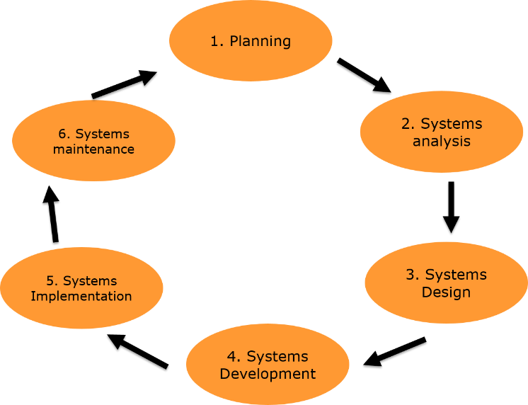
phases I: Planning

Slide 10

Planning
Set goal and scope
Select lifecycle
Set org./team form
Start team selection
Determine risks
Create WBS
Identify tasks
Note: with Gantter tool and MS project you can create this kind of documents.
User need
Document of risks
WBS document
Document of resource
Notes:
Set goal and scope
Select lifecycle
Set org./team form
Start team selection
Determine risks
Create WBS (work breakdown structure)
Identify tasks
http://acronyms.thefreedictionary.com/GOAL

Slide 11
Planning
Exercise 1:
User need
Document of risks
WBS document
Document of resource

Slide 12
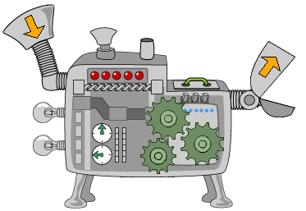
Input
User needs
A scope and a goal
Output
Resource list
A list of tasks
A list of risks
Time estimation
Recommend tool: Gantter
Planning
Notes:
Activity: wrong gantter
Half of planning
Student and compare with other group

Slide 13
phases Ii: Analysis
Determined problem to solve by the system.

Slide 14
System analysis
Is to determine where the problem is in an attempt to fix the system.
Check Understanding..!
Notes:
This step involves breaking down the system in different pieces to analyze the situation, analyzing project goals, breaking down what needs to be created and attempting to engage users so that definite requirements can be defined.
The analysis phases answers the questions of who will use the system, what the system will do and where and when it will be used.
During the phase the project team investigates and current system, identifies improvement opportunities, and develops and concept for the new system.
This phase has three analysis steps
Analysis strategy: This is developed to guide the projects team’s efforts. This includes and analysis of the current system.
Requirements gathering: the analysis of this information leads to the development of a concept for a new system. This concept is used to build a set of analysis models.
System proposal: The proposal is presented to the project sponsor and other key individuals who decide whether the project should continue to move for award

Slide 15

System analysis
Where are three main part in analysis:
What needs to be created

Slide 16
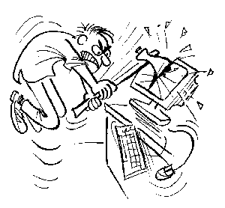
System analysis
Breaking down the system in different pieces to analyze the situation

Slide 17
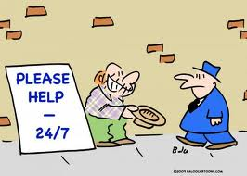
System analysis
Ask users for help to determine the requirements

Slide 18
System analysis
At the end of this phase we have a functional requirement document that describe precisely the functionalities and the processes of the system.
Example:
Functional requirement
Use Case

Slide 19
Input
An expert of the business user
Data sample from existing business
Output
A Functional requirement
An User Story
An Use Case
Analysis
Notes:
Reuse: UML diagram
Working detail on each task

Slide 20

System Design

Slide 21

System Design
Is to satisfy requirement with the process of defining the
Architecture
Components
Modules
Interfaces (Wireframe/ Mockup)
Data for a system (Class diagram…)
Notes:
Systems design is the process of defining the architecture, components, modules, interfaces, and data for a system to satisfy specified requirements. Systems design could be seen as the application of systems theory to product development. There is some overlap with the disciplines of systems analysis, systems architecture and systems
http://en.wikipedia.org/wiki/Systems_design#Architectural_design

Slide 22

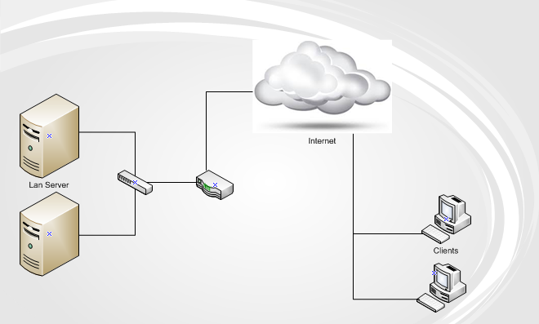
Example: Library system design Architecture
Notes:
The architectural design of a system emphasizes on the design of the systems architecture which describes the structure, behavior, and more views of that system.

Slide 23
Example: Library system design Components
wordpress.com
Components
Front end UI
www.wordpress.com
Back end UI
www.wordpress.com/admin

Slide 24
Example: Library system design Modules
New User Master
View User
Change Password
Book Master
Publisher
Member Master
Library Card
Book Issue
…….

Slide 25
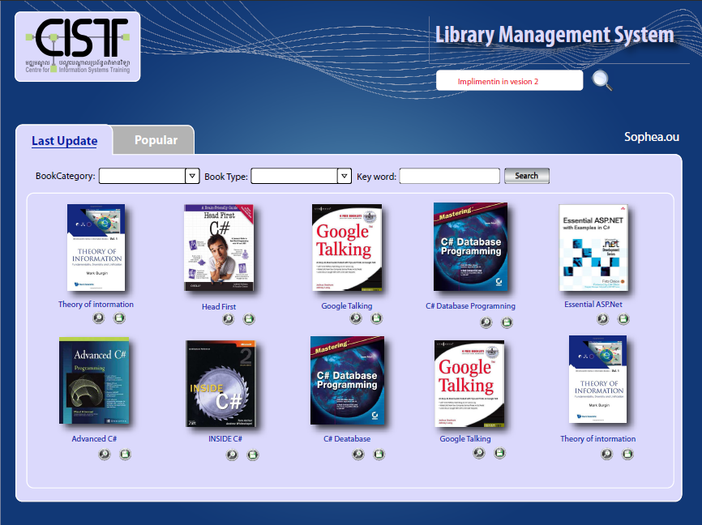
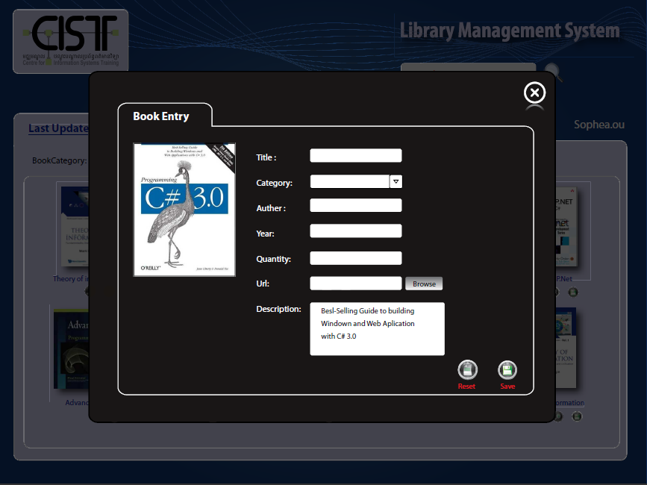
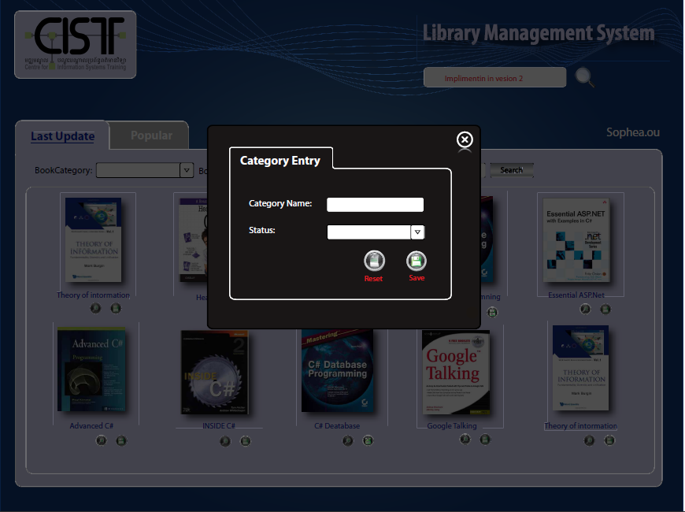
Example: Library system design Interfaces

Slide 26
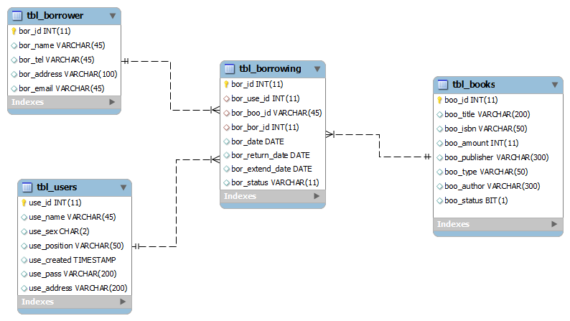
Example: Library system design Data for a system

Slide 27
Input
A Functional requirement
An User Story
An Use Case
Output
An Architecture
An Components list
A Modules list
Wireframe/ Mockup
Class diagram
System Design
Notes:
Balsamin

Slide 28
4. System Development
Built and tested to make sure it performs as designed

Slide 29
System Development
Write the code according to the design
Integrate the components(plugin/API).
Get feedback from the customer
Don’t optimize performance until you achieve functionality
Reviewed by designers, coders, testers
Make it work..!

Slide 30
Input
An Architecture
An Components list
A Modules list
Wireframe/ Mockup
Class diagram
Coding rule
Code structure
Company rule (version control…)
Coding
Output
Beta version of the system
Code tracking
Development
Notes:
Modules deverlop

Slide 31
5. Systems Implementation
To deploy the system for the customer (Rule it out)

Slide 32
Systems Implementation
Put the product in the hands of customers
When release new version do not disrupting existing customers
Notes:
Roll-out strategy must ramp-up without disrupting existing customers

Slide 33
Input
Beta version of the system
Output
Product or
Final version of the system
Implementation
Notes:
Hosting the project
Training (User menu)
Customer testing report (customer feedback hard to understand for the developer)
Bug list

Slide 34
6. Systems maintenance

Slide 35
Maintenance
Help people cope with change
Training, close support, talk to they make sure they happy with the system
Separate first impressions from real issues
What works, what doesn’t
Listen to your customer

Slide 36
Input
Final version of the system
Output
Customer rate (satisfaction)
Improvement points
Maintenance
Notes:
Helpdesk simulation (student need to identifier the customer feedback, it a new requirement? )

